Slide 1





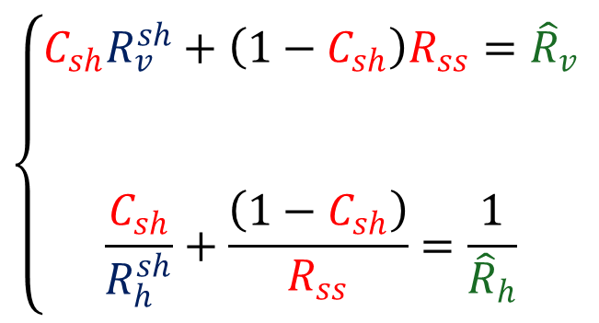

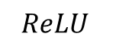

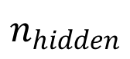

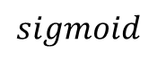
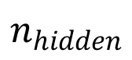



$$x$$
$$R_{v}$$
constraint
$$θ$$
$$\hat{x}$$
$$R_{h}$$
$$C_{sh}$$
$$\left\{\begin{matrix}\begin{aligned}C_{sh}R_{v}^{sh}+\left(1−C_{sh}\right)R_{ss}={\hat{R}}_{v} \\ \\ \end{aligned} \\ \frac{C_{sh}}{R_{h}^{sh}}+\frac{\left(1−C_{sh}\right)}{R_{ss}}=\frac{1}{{\hat{R}}_{h}}\end{matrix}\right.$$
$${\hat{R}}_{v}$$
$$sigmoid$$
$$R_{v}^{sh}$$
$$ReLU$$
$$R_{ss}$$
$${\hat{R}}_{h}$$
…
…
$$R_{h}^{sh}$$
$$n_{hidden}$$
$$n_{hidden}$$

Slide 2
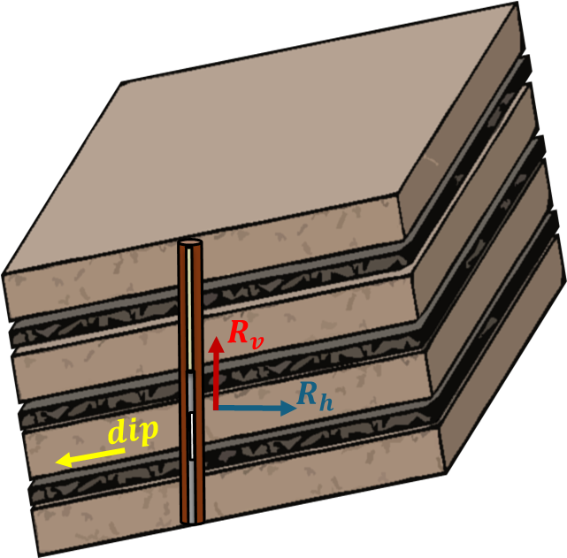
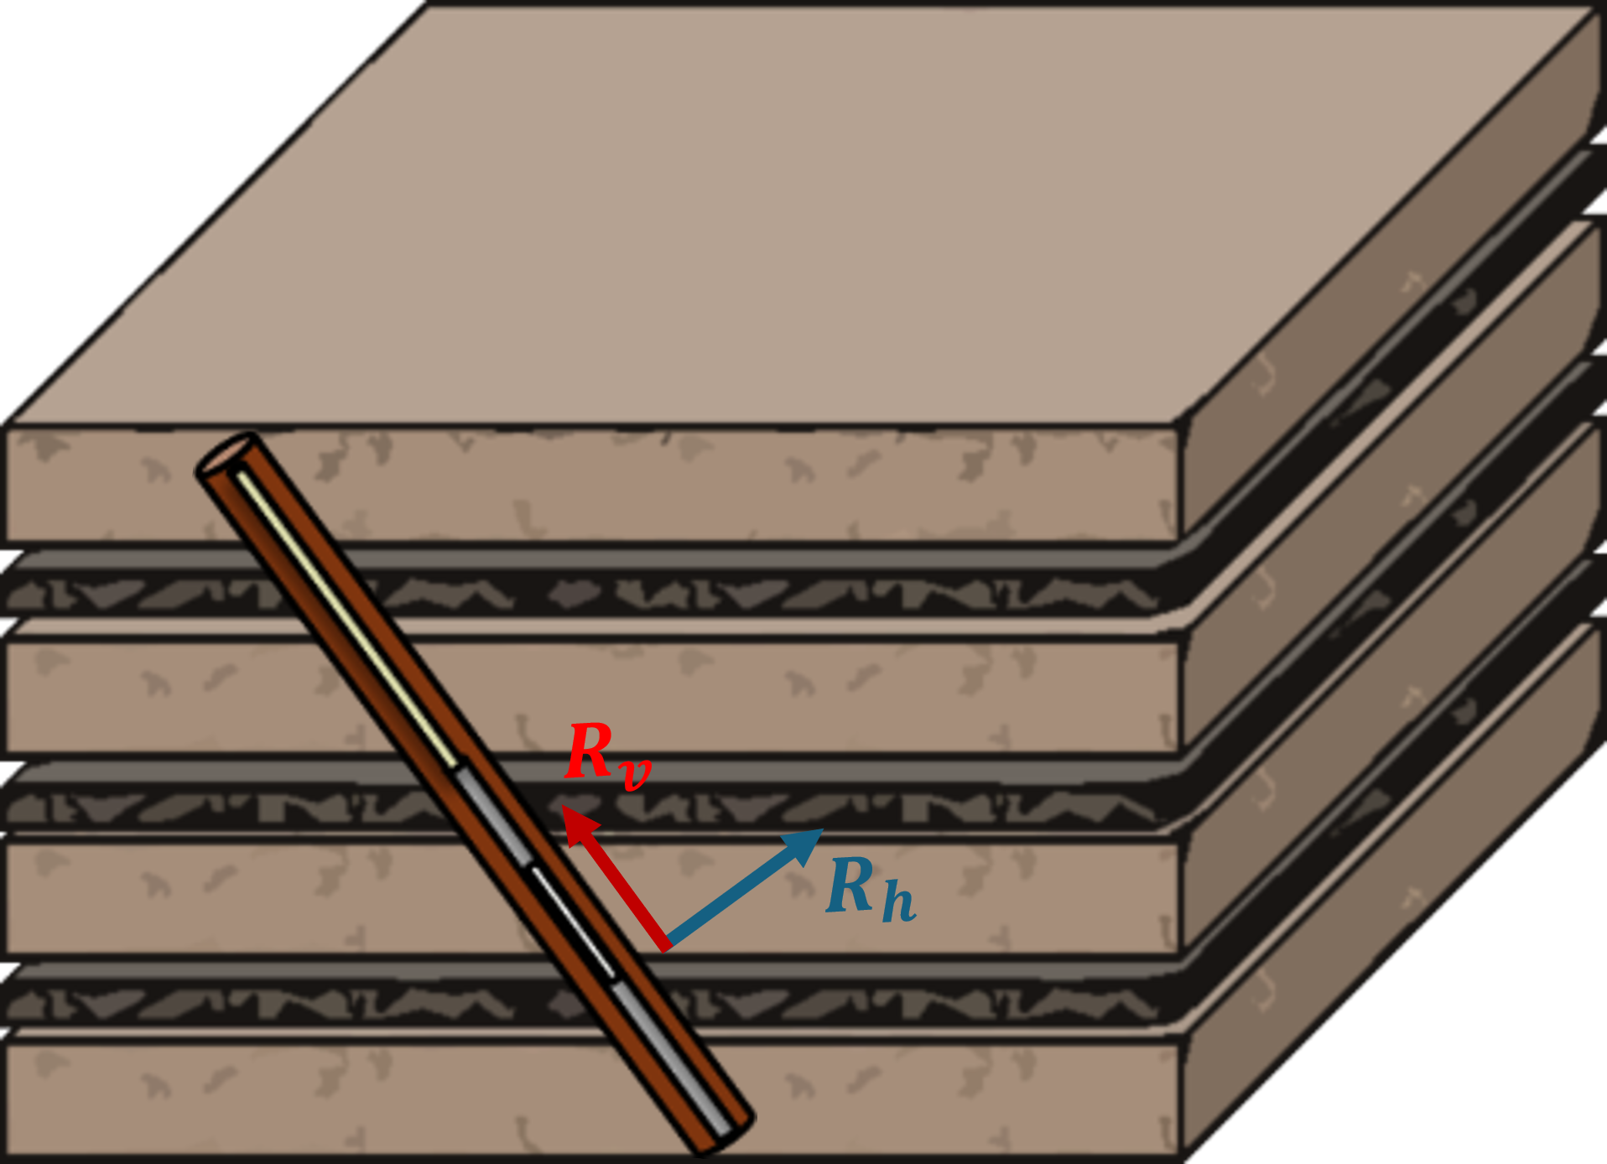
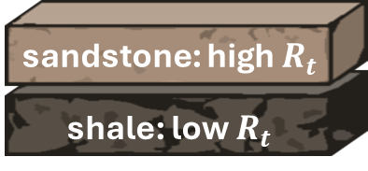
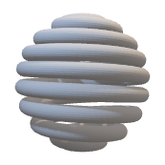




Triaxial resistivity coils
$$R_{v}$$
$$R_{h}$$
$$dip/deviation$$

Slide 3
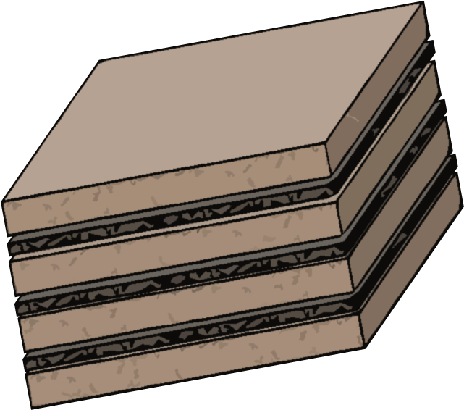
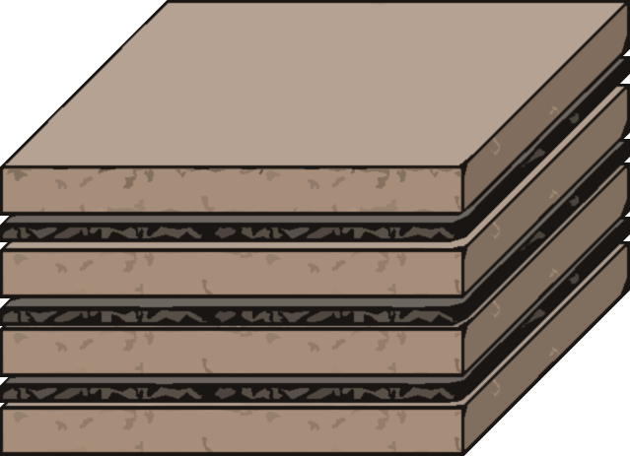
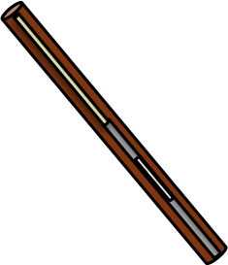



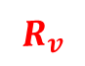

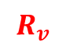
$$R_{v}$$
$$R_{v}$$
$$R_{h}$$
$$R_{h}$$
$$dip$$

Slide 4



Slide 6
